Slide 1
Tidy and explore tabular data with pandas
Zoë Wilkinson Saldaña, MSI
Arcus Education, DBHi

Slide 2

Hello!
Background: data science, computational social science; academic libraries (Cornell University, University of Michigan)
Research interests: data visualization pedagogy; FOSS; LGBTQIA+ online communities
ALSO: pinball, cats, trains, games
Zoë Wilkinson Saldaña, MSI
Data Instructional Specialist
Arcus Education

Slide 3
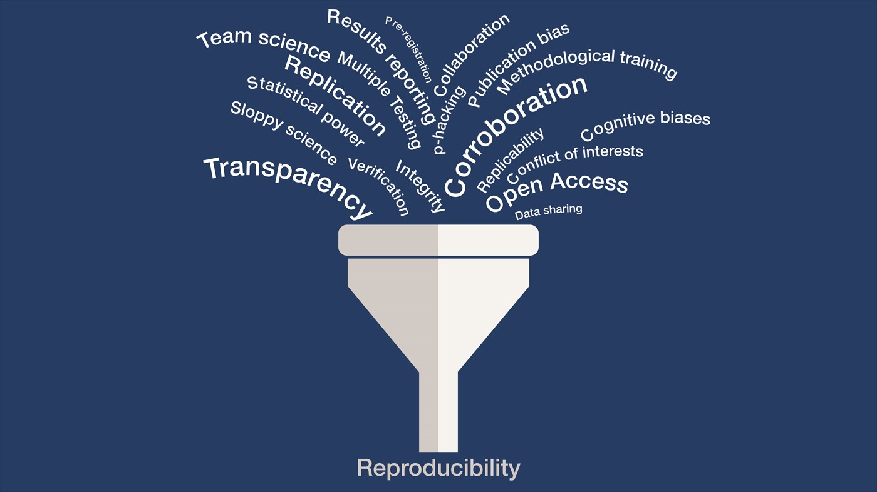
Python for Reproducible Research Skill Series
https://publichealth.yale.edu/ehs/news-article/17224/

Slide 4
Python for Reproducible Research Skill Series
A workflow for reproducible data science using Python ecosystem of tools (Jupyter Notebooks, pandas, etc.)
A way of thinking about exploratory data analysis in medical research: sound statistical reasoning + data science best practices
A community of practice for you to connect, share, and grow as a data scientist

Slide 5

Turn to your neighbor
What project are you working on, or hope to work on, involving data science skills?
How do you imagine using Python would help this project?
What’s your top learning goal coming into today’s workshop?
Icons made by Freepik from www.flaticon.com

Slide 6
What can you accomplish in a Notebook with pandas?

Slide 7
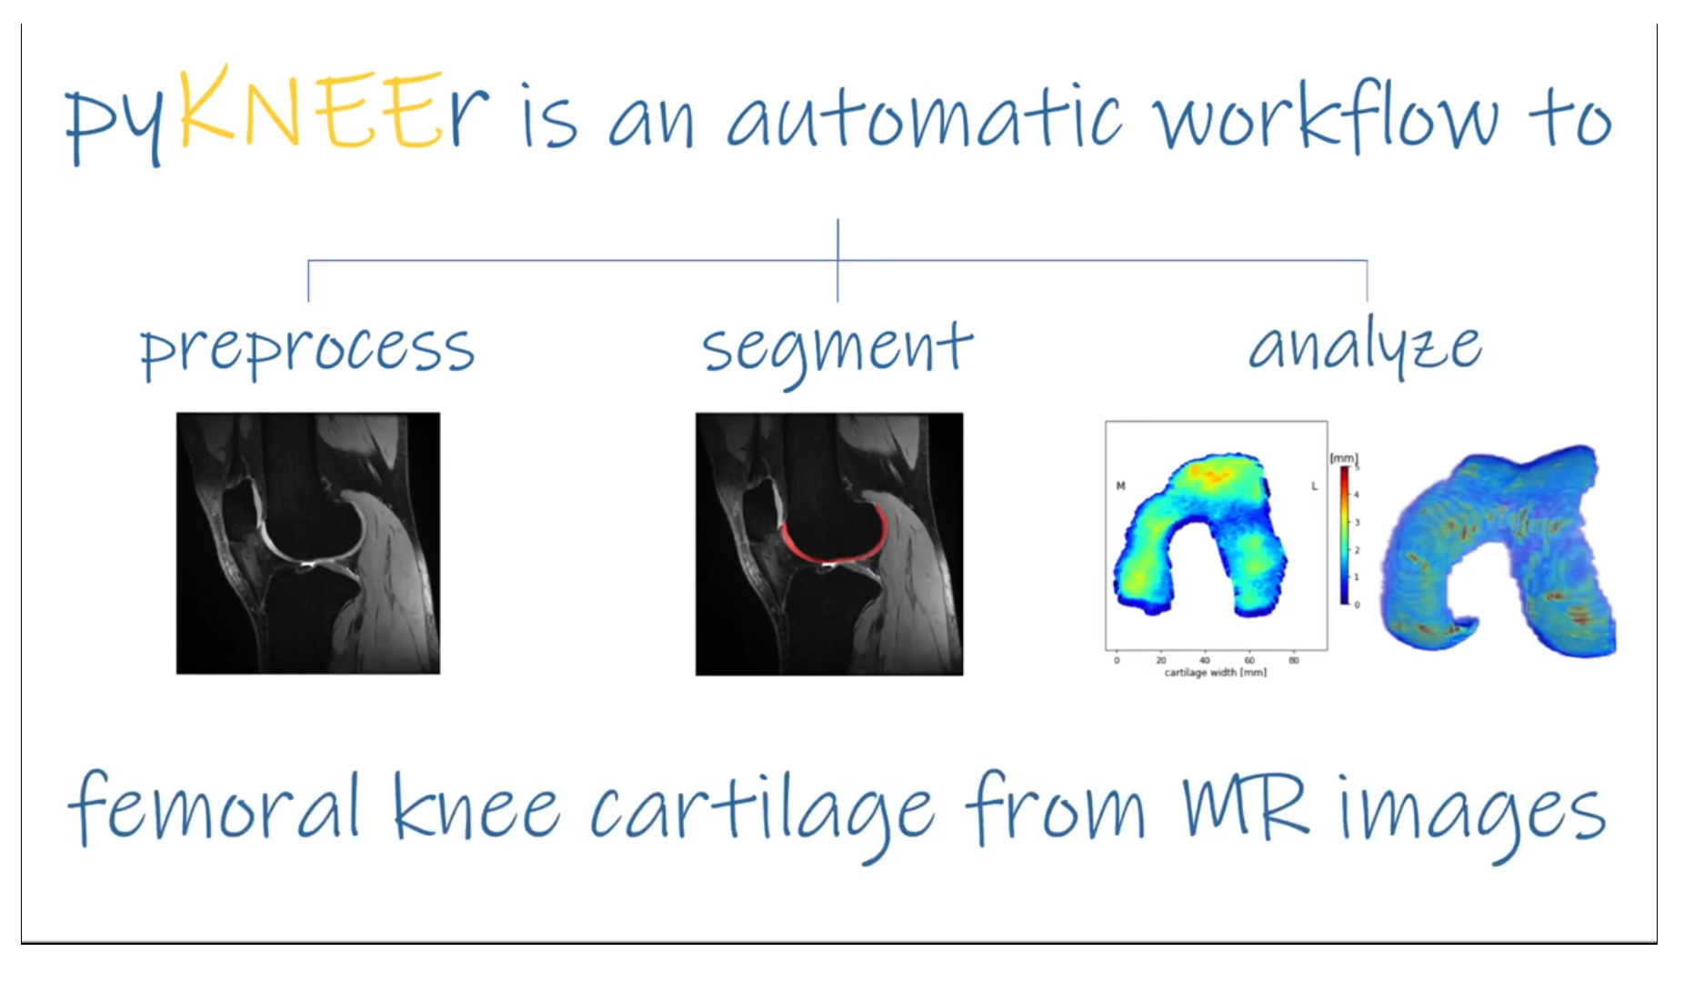
https://sbonaretti.github.io/pyKNEEr/

Slide 8
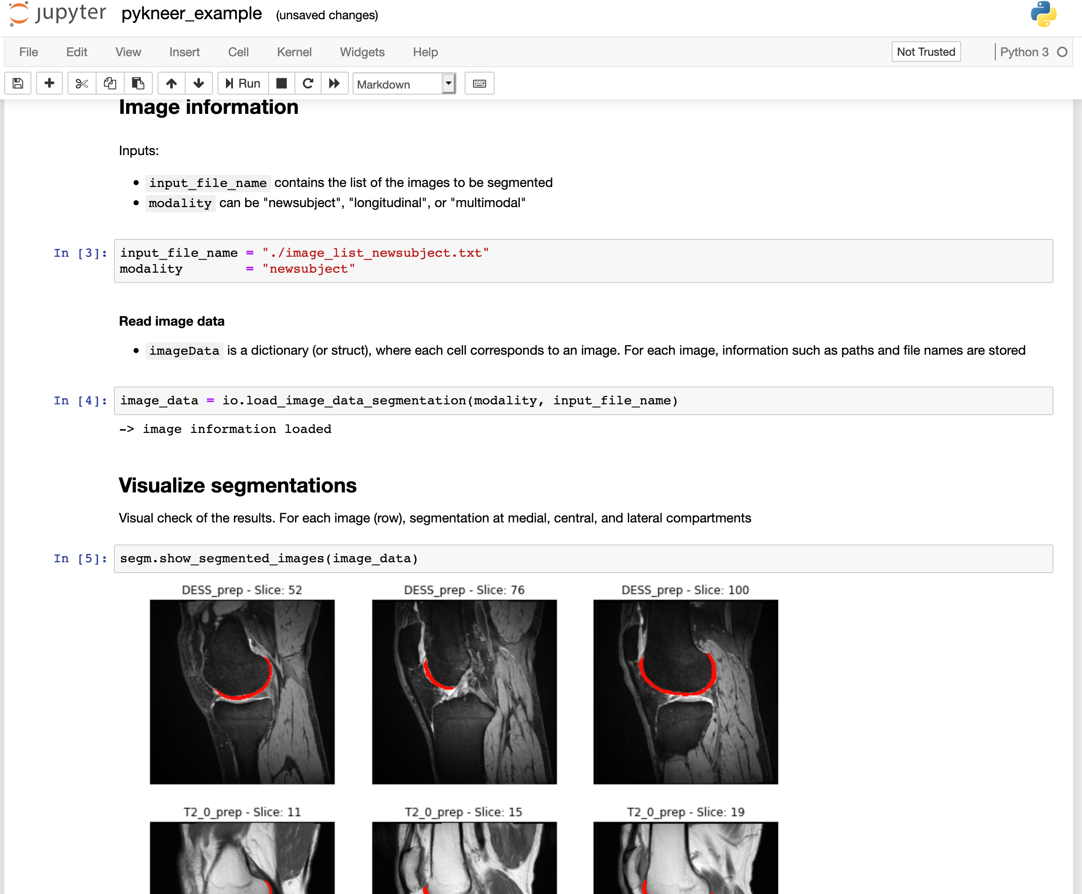
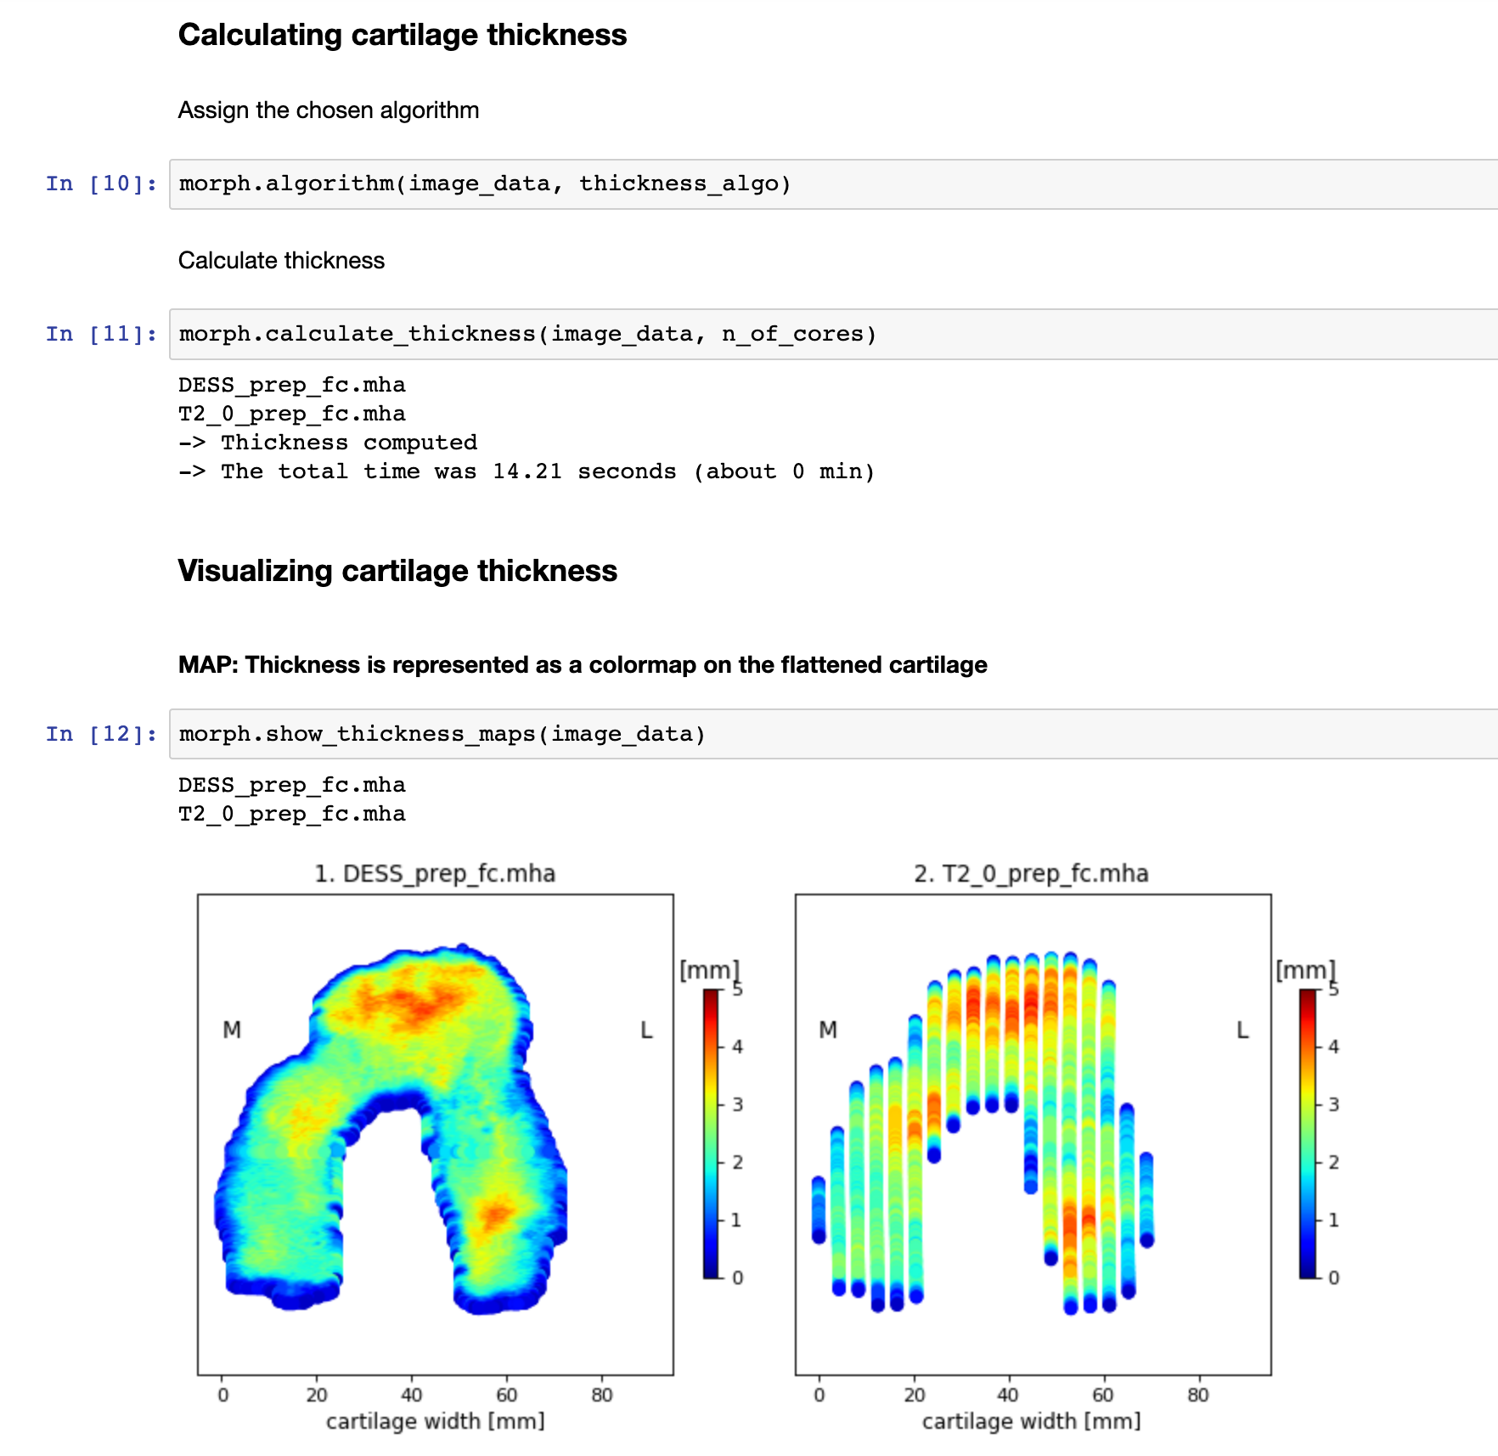
“pyKNEEr: An image analysis workflow for open and reproducible research on femoral knee cartilage” (2019)
https://www.biorxiv.org/content/10.1101/556423v2.full

Slide 9
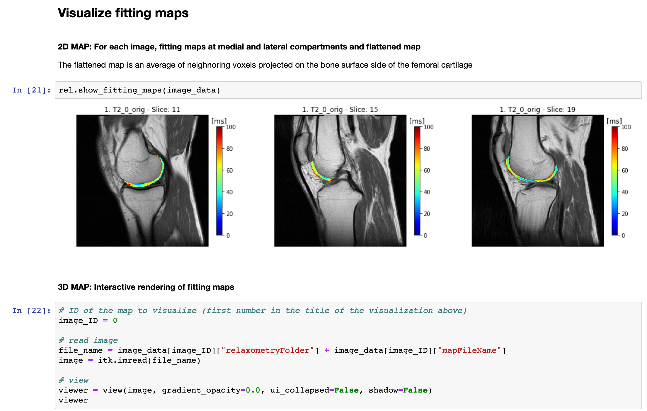
“pyKNEEr: An image analysis workflow for open and reproducible research on femoral knee cartilage” (2019)
https://www.biorxiv.org/content/10.1101/556423v2.full

Slide 10
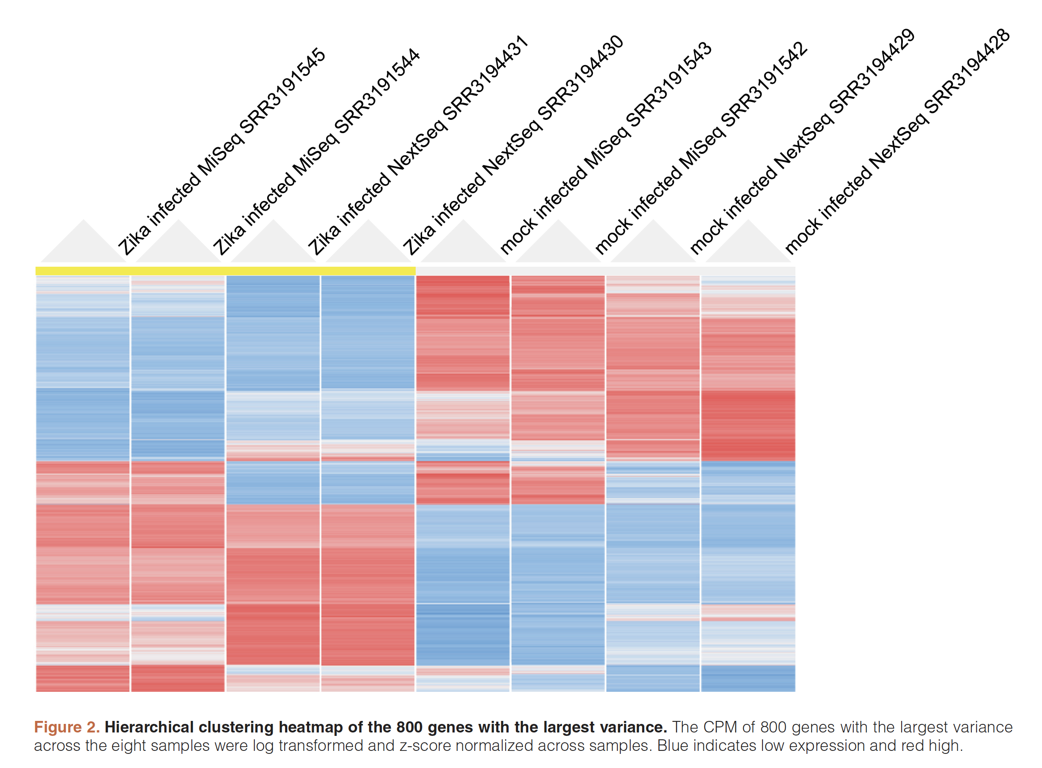
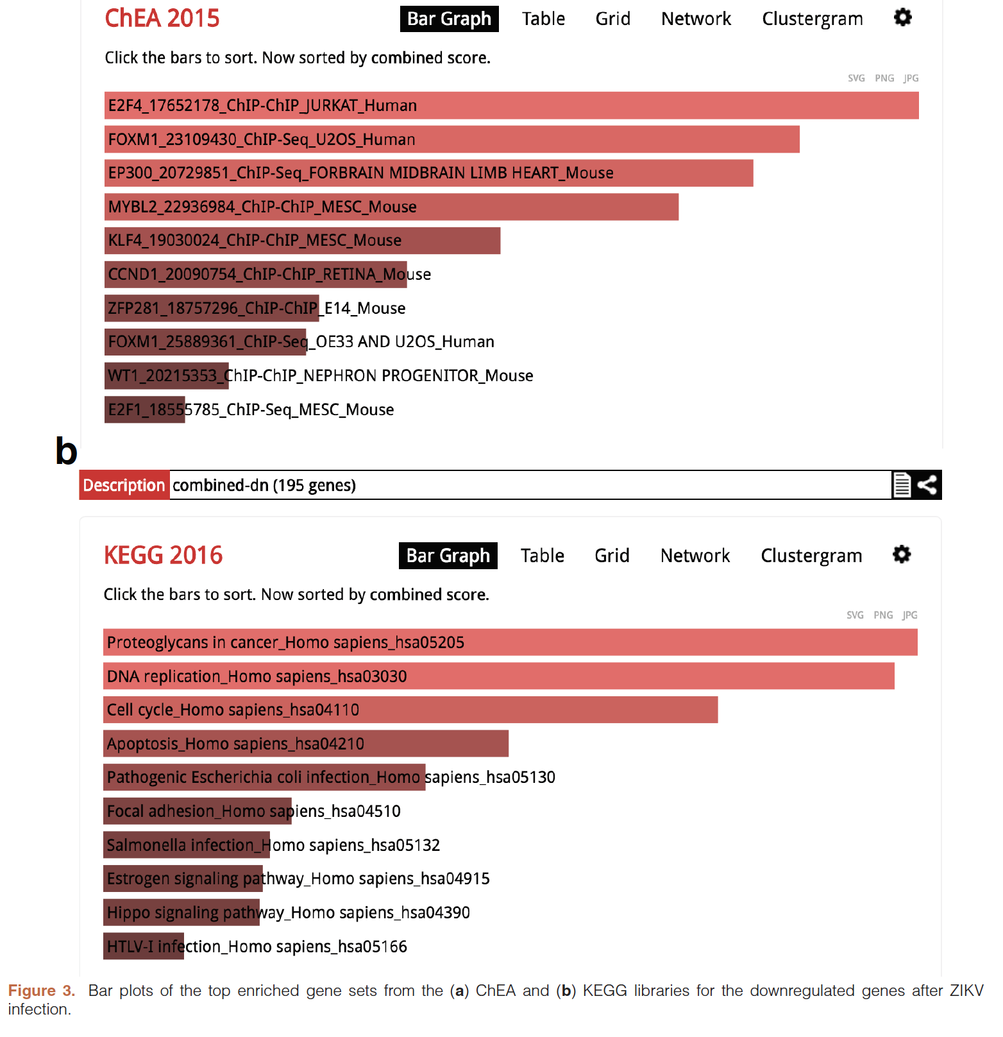
“An open RNA-Seq data analysis pipeline tutorial with an example of reprocessing data from a recent Zika virus study”
RNA-
seq
data
“The aim of the study was to begin to understand the molecular mechanisms that induce the observed devastating phenotype of newborn-microcephaly from pregnant mothers infected with the virus.”

Slide 11
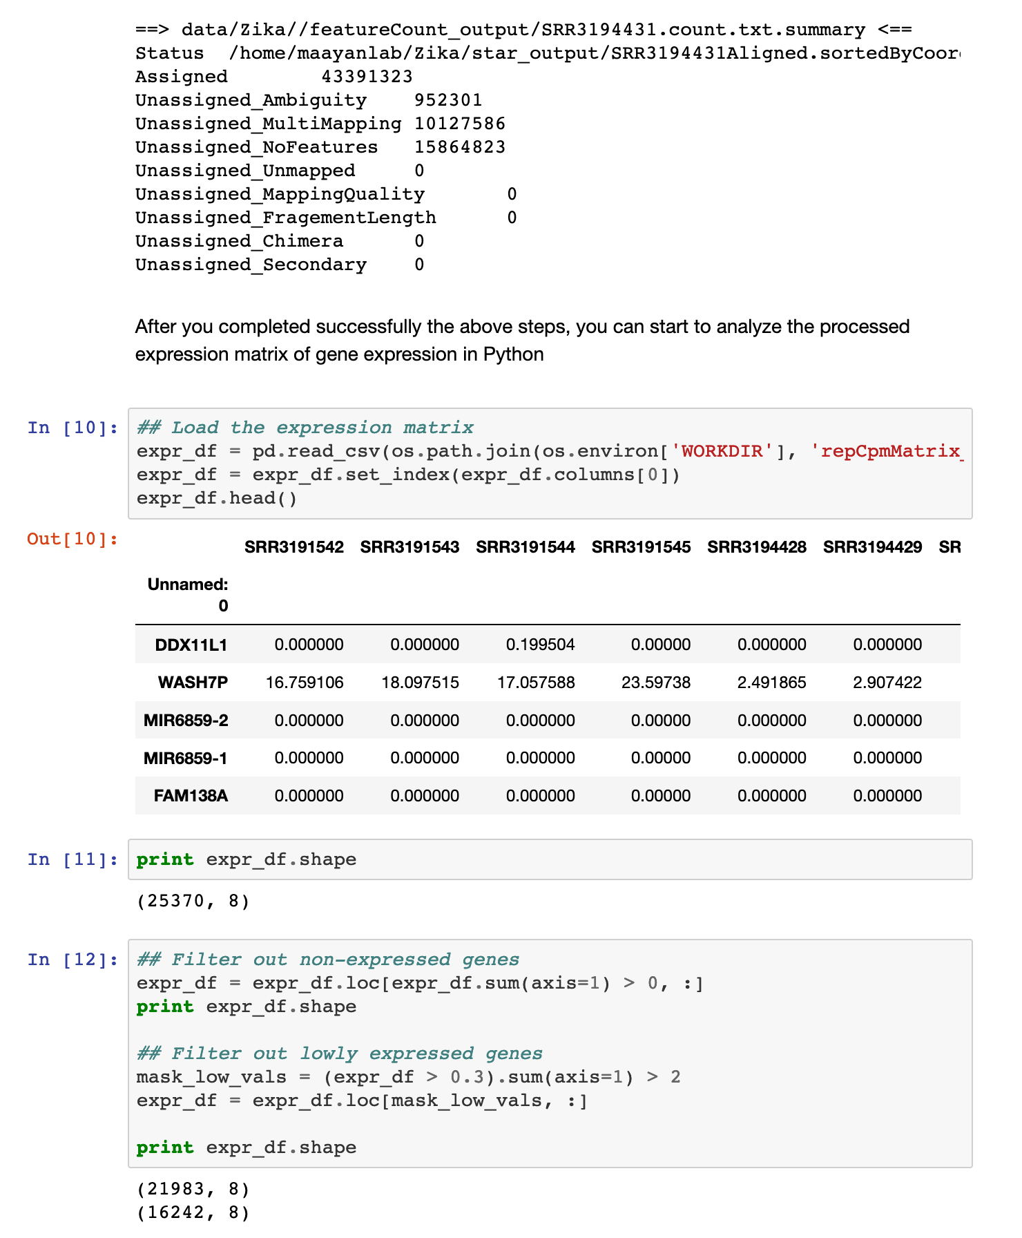
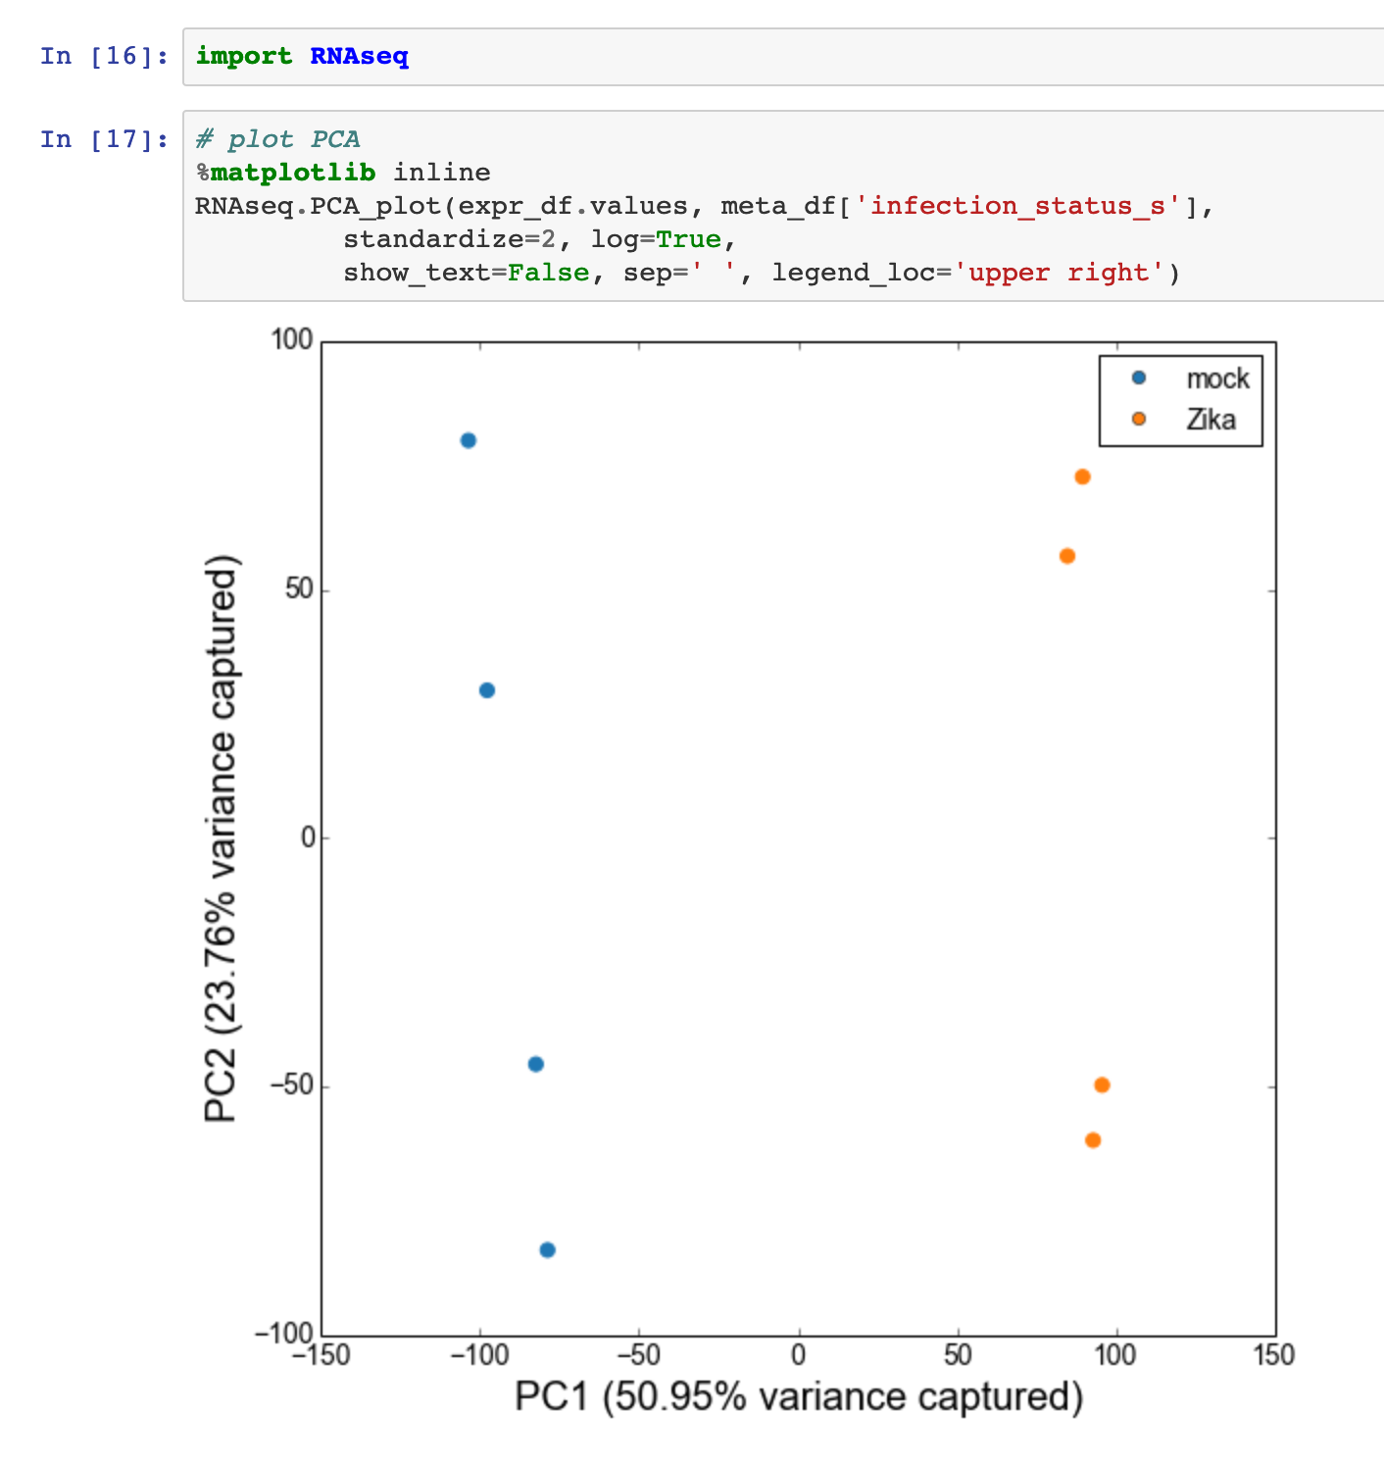
“An open RNA-Seq data analysis pipeline tutorial with an example of reprocessing data from a recent Zika virus study”
https://nbviewer.jupyter.org/github/maayanlab/Zika-RNAseq-Pipeline/blob/master/Zika.ipynb¶

Slide 12
Python for Reproducible Research Skill Series
Ask research questions!
Get your data
Prepare your data
Explore your data
Model your data
Communicate your data

Slide 13
Python for Reproducible Research Skill Series
Ask research questions!
Get your data (fetch, import, query)
Prepare your data (tidy, structure)
Explore your data (summarize, visualize)
Model your data (predict, classify, infer)
Communicate your data (narrate, visualize, share)

Slide 14
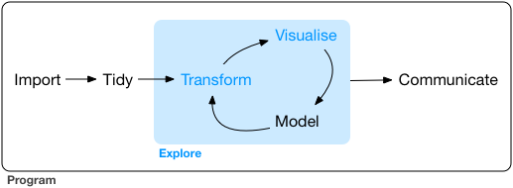
Python for Reproducible Research Skill Series

Slide 15
Keep learning! Further resources
Kevin Markham’s pandas videos
https://github.com/justmarkham/pandas-videos
Books:
Python Data Science Handbook by Jake VanderPlas.
2nd edition available for free online
Pandas for Everyone by Daniel Chen
https://github.com/chendaniely/pandas_for_everyone

Slide 16
Keep learning! Further resources
“Ten Simple Rules for Reproducible Research in Jupyter Notebooks” (2018)
https://arxiv.org/abs/1810.08055
A gallery of interesting Jupyter Notebooks
https://github.com/jupyter/jupyter/wiki/A-gallery-of-interesting-Jupyter-Notebooks

